Slide 1
Faltende neuronale netze
Eine Präsentation von Benjamin Jank

Slide 2
Übersicht über Maschinelles Lernen
Künstliche Intelligenz
„ist ein Teilgebiet der Informatik. Sie imitiert menschliche kognitive Fähigkeiten [...]. Diese Intelligenz kann auf programmierten Abläufen basieren oder durch maschinelles Lernen erzeugt werde.“ (Frauenhofer-Institut für Kognitive Systeme IKS)
Maschinelles Lernen
„ist ein Teilbereich der künstlichen Intelligenz (KI). Der Schwerpunkt liegt auf dem Trainieren von Computern, damit diese aus Daten und Erfahrungen lernen […] – anstatt explizit dafür programmiert zu werden.“ (SAP)
Algorithmen
Maschinelles Lernen

Slide 3
Übersicht über Maschinelles Lernen
Algorithmen
Maschinelles Lernen
Input
Input
f(x)
Zustand
f(x)
Output
Output

Slide 4
Übersicht über Maschinelles Lernen
Maschinelles Lernen
Überwachtes
Lernen
Unüberwachtes
Lernen
Bestärkendes
Lernen
Klassifizierung
Regression

Slide 5
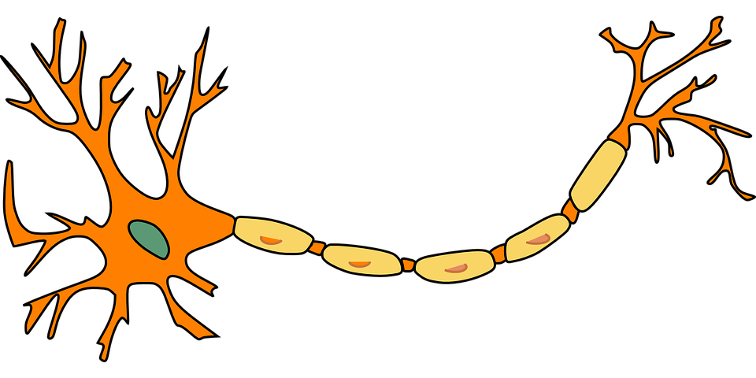
Funktionsweise faltender neuronaler Netze

Slide 6
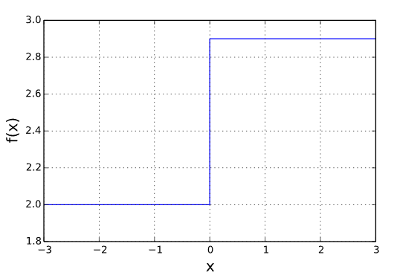
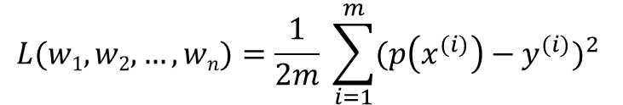
Das Single Layer Perceptron
p(x)
Die Fehlerfunktion
Parameter von Model als Eingabe
Gibt Abweichung des Models von Wahrheitswerten zurück
Mean Squared Error Funktion:
w₁
z = X₁*w₁ + X₂*w₂ + … + X_{n}*w_{n}
Y = f(z)
X₁
w₂
X₂
Y
…
$$L(w1, w2, …, wn)=\frac{1}{2m} \sum_{i=1}^{m}{{(p\left(x^{(i)}\right)−y^{(i)})}^{2} }$$
w_{n}
X_{n}

Slide 7
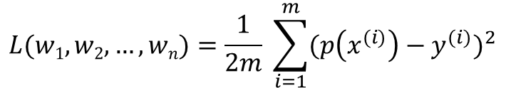
Das Single Layer Perceptron
p(x)
$$L(w1, w2, …, wn)=\frac{1}{2m} \sum_{i=1}^{m}{{(p\left(x^{(i)}\right)−y^{(i)})}^{2} }$$
w₁
z = X₁*w₁ + X₂*w₂ + … + X_{n}*w_{n}
Y = f(z)
Das Gradientenverfahren
Iterativer Algorithmus, um differenzierbare Funktion zu minimieren
Hilfsmittel, um Fehlerfunktion zu optimieren
X₁
w₂
X₂
Y
…
w_{n}
X_{n}

Slide 8
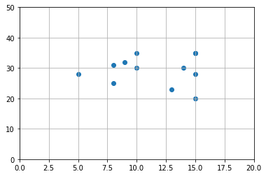
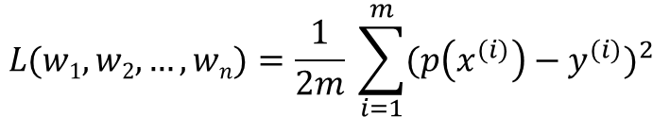
Das Single Layer Perceptron
p(x)
$$L(w1, w2, …, wn)=\frac{1}{2m} \sum_{i=1}^{m}{{(p\left(x^{(i)}\right)−y^{(i)})}^{2} }$$
w₁
z = X₁*w₁ + X₂*w₂ + … + X_{n}*w_{n}
Y = z
Das Gradientenverfahren
Iterativer Algorithmus, um differenzierbare Funktion zu minimieren
Hilfsmittel, um Fehlerfunktion zu optimieren
X₁
w₂
X₂
Y
…
w_{n}
X_{n}

Slide 9
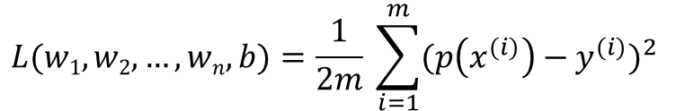
Das Single Layer Perceptron
p(x)
$$L(w1, w2, …, wn,b)=\frac{1}{2m} \sum_{i=1}^{m}{{(p\left(x^{(i)}\right)−y^{(i)})}^{2} }$$
w₁
z = X₁*w₁ + X₂*w₂ + … + X_{n}*w_{n} + b
Y = z
Das Gradientenverfahren
Iterativer Algorithmus, um differenzierbare Funktion zu minimieren
Hilfsmittel, um Fehlerfunktion zu optimieren
X₁
w₂
X₂
Y
…
w_{n}
X_{n}
b

Slide 10
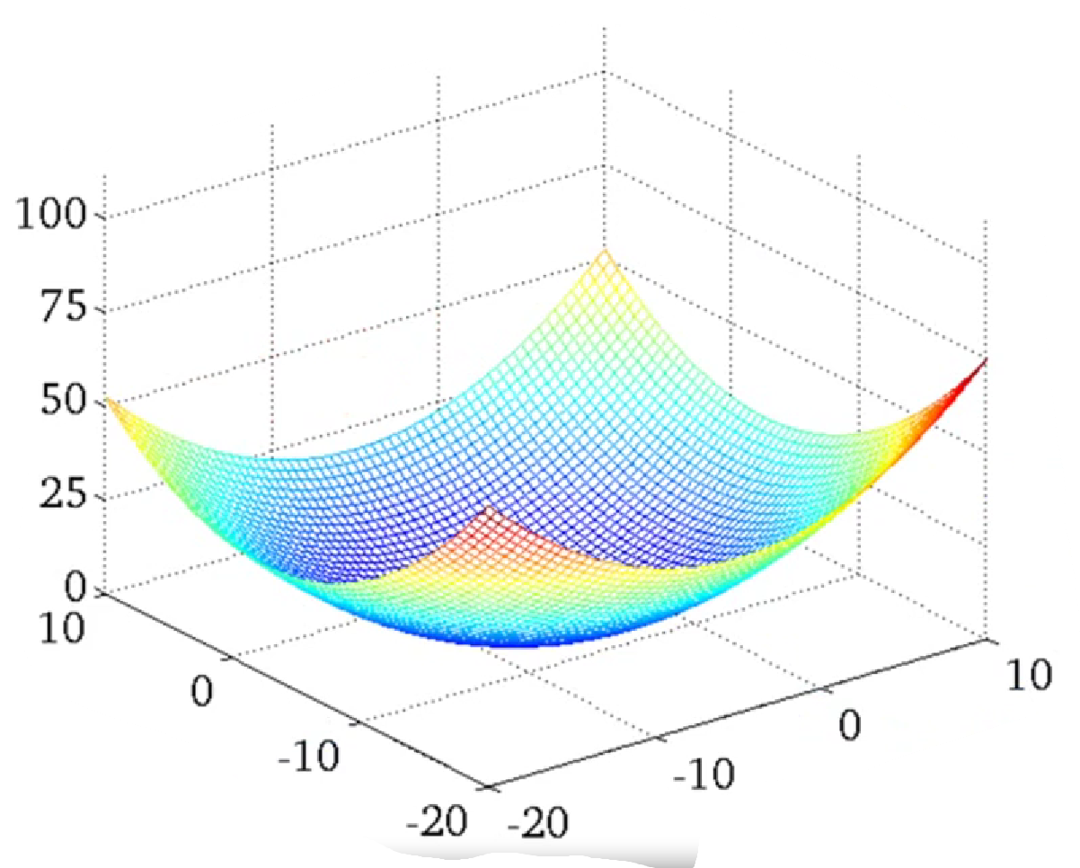
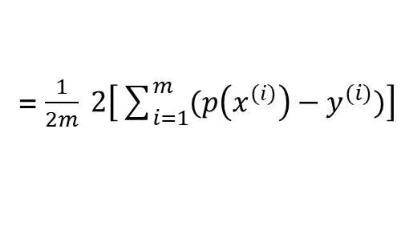
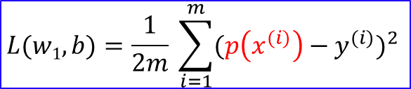






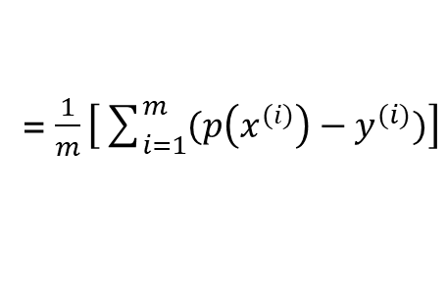
Das Gradientenverfahren
$$\text{w}\text{1} ≔\text{w}\text{1}−α∗\frac{∂\text{L}}{∂\text{w}\text{1}} \\ b≔b−α∗\frac{∂\text{L}}{∂\text{b}}$$
$$L(w1, b)=\frac{1}{2m} \sum_{i=1}^{m}{{(p\left(x^{(i)}\right)−y^{(i)})}^{2} }$$
$p\left(x^{(i)}\right)$ = ${x1}^{(i)}∗w1+b$
$\frac{∂\text{L}}{∂\text{v}}$ = $\frac{∂\text{L}}{∂p\left(x^{(i)}\right)}\frac{∂p\left(x^{(i)}\right)}{∂\text{v}}$
$\frac{∂\text{L}}{∂p\left(x^{(i)}\right)}$ = $\frac{∂}{∂p\left(x^{(i)}\right)}$ $\left[\frac{1}{2m}\sum_{i=1}^{m}{{(p\left(x^{(i)}\right)−y^{(i)})}^{2} }\right]$
x P
= $\frac{1}{2m} \frac{∂}{∂p\left(x^{(i)}\right)}$ $\left[\sum_{i=1}^{m}{{(p\left(x^{(i)}\right)−y^{(i)})}^{2} }\right]$
L
= $\frac{1}{2m} \left[\sum_{i=1}^{m}{{\frac{∂}{∂p\left(x^{(i)}\right)} (p\left(x^{(i)}\right)−y^{(i)})}^{2} }\right]$
= $\frac{1}{2m} \left[\sum_{i=1}^{m}{2(p\left(x^{(i)}\right)−y^{(i)})}∗\frac{∂}{∂p\left(x^{(i)}\right)} (p\left(x^{(i)}\right)−y^{(i)})\right]$
= $\frac{1}{2m} 2\left[\sum_{i=1}^{m}{(p\left(x^{(i)}\right)−y^{(i)})}\right]$
= $\frac{1}{m}\left[\sum_{i=1}^{m}{(p\left(x^{(i)}\right)−y^{(i)})}\right]$
w₁
b

Slide 11
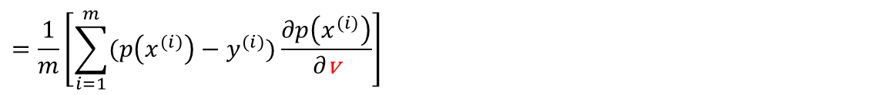
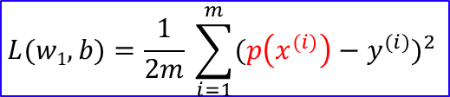
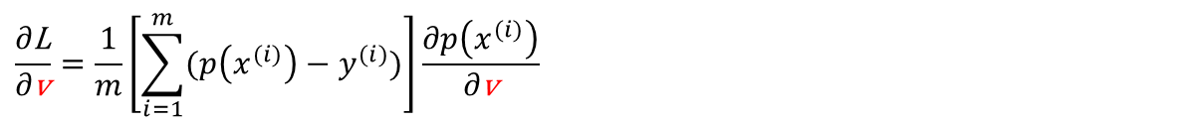

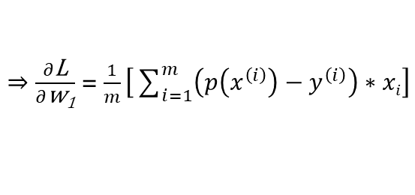

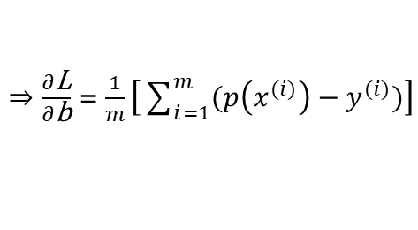
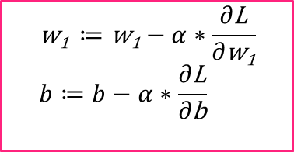
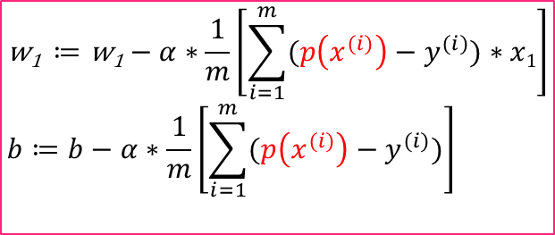
Das Gradientenverfahren
$$\text{w}\text{1} ≔\text{w}\text{1}−α∗\frac{∂\text{L}}{∂\text{w}\text{1}} \\ b≔b−α∗\frac{∂\text{L}}{∂\text{b}}$$
$$L(w1, b)=\frac{1}{2m} \sum_{i=1}^{m}{{(p\left(x^{(i)}\right)−y^{(i)})}^{2} }$$
$p\left(x^{(i)}\right)$ = ${x1}^{(i)}∗w1+b$
$\frac{∂\text{L}}{∂\text{v}}$ = $\frac{∂\text{L}}{∂p\left(x^{(i)}\right)}\frac{∂p\left(x^{(i)}\right)}{∂\text{v}}$
$$\frac{∂\text{L}}{∂\text{v}}=\frac{1}{m}\left[\sum_{i=1}^{m}{(p\left(x^{(i)}\right)−y^{(i)})}\right]\frac{∂p\left(x^{(i)}\right)}{∂\text{v}}$$
$$=\frac{1}{m}\left[\sum_{i=1}^{m}{(p\left(x^{(i)}\right)−y^{(i)})}\frac{∂p\left(x^{(i)}\right)}{∂\text{v}}\right]$$
x P
$⇒\frac{∂\text{L}}{∂\text{b}}$ = $\frac{1}{m}\left[\sum_{i=1}^{m}{(p\left(x^{(i)}\right)−y^{(i)})}\right]$
L
$⇒\frac{∂\text{L}}{∂\text{w}\text{1}}$ = $\frac{1}{m}\left[\sum_{i=1}^{m}{\left(p\left(x^{\left(i\right)}\right)−y^{\left(i\right)}\right)∗xi}\right]$
$$\text{w}\text{1} ≔\text{w}\text{1}−α∗\frac{1}{m}\left[\sum_{i=1}^{m}{(p\left(x^{(i)}\right)−y^{(i)})}∗x1\right] \\ b≔b−α∗\frac{1}{m}\left[\sum_{i=1}^{m}{(p\left(x^{(i)}\right)−y^{(i)})}\right]$$
w₁
b

Slide 12
Das Single Layer Perceptron
p(x)
w₁
z = X₁*w₁ + X₂*w₂ + … + X_{n}*w_{n} + b
Y = z
X₁
w₂
X₂
Y
…
w_{n}
X_{n}
b
1

Slide 13
Das Single Layer Perceptron
p(x)
w₁
z = X₁*w₁ + X₂*w₂ + … + X_{n}*w_{n} + b
Y = f(z)
X₁
w₂
X₂
Y
…
w_{n}
X_{n}
b
1

Slide 14
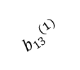
















Das Multilayer Perceptron
z₁⁽²⁾ a₁⁽²⁾
$${w22}^{(2)}$$
$${w11}^{(1)}$$
$${w32}^{(2)}$$
x₁
$${w21}^{(1)}$$
z₁⁽³⁾ a₁⁽³⁾
$${w31}^{(1)}$$
$${w22}^{(2)}$$
$${w12}^{(1)}$$
z₂⁽²⁾ a₂⁽²⁾
$${w32}^{(2)}$$
$${w22}^{(1)}$$
x₂
$${w32}^{(1)}$$
z₂⁽³⁾ a₂⁽³⁾
$${w22}^{(2)}$$
$${b13}^{(1)}$$
$${w32}^{(2)}$$
$${b23}^{(1)}$$
z₃⁽²⁾ a₃⁽²⁾
₁
$${b33}^{(1)}$$
$${b11}^{(2)}$$
$${b21}^{(2)}$$
₁
L1
L2
L3

Slide 15

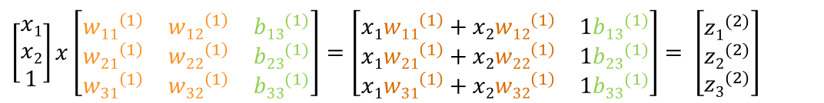

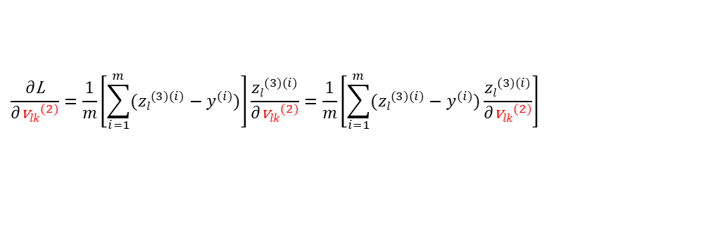
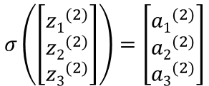
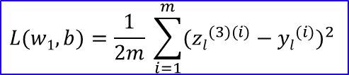
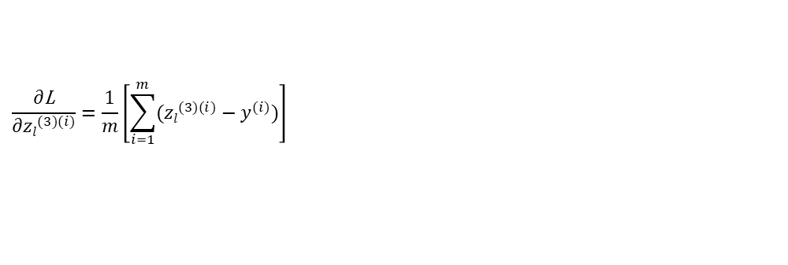


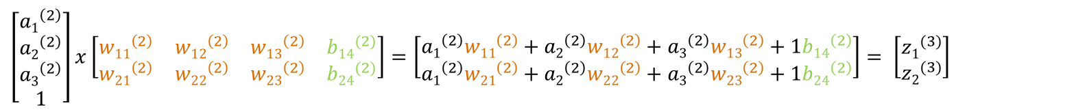

Das Multilayer Perceptron
$\left[\begin{matrix}x1 \\ x2 \\ 1\end{matrix}\right]x\left[\begin{matrix}{w11}^{\left(1\right)} & {w12}^{\left(1\right)} & {b13}^{(1)} \\ {w21}^{\left(1\right)} & {w22}^{\left(1\right)} & {b23}^{(1)} \\ {w31}^{\left(1\right)} & {w32}^{\left(1\right)} & {b33}^{(1)}\end{matrix}\right]$ $=\left[\begin{matrix}x1{w11}^{\left(1\right)}+x2{w12}^{\left(1\right)} & 1{b13}^{(1)} \\ x1{w21}^{\left(1\right)}+x2{w22}^{\left(1\right)} & 1{b23}^{(1)} \\ x1{w31}^{\left(1\right)}+x2{w32}^{\left(1\right)} & 1{b33}^{(1)}\end{matrix}\right]$ $= \left[\begin{matrix}{z1}^{(2)} \\ {z2}^{(2)} \\ {z3}^{(2)}\end{matrix}\right]$
$$σ\left(\left[\begin{matrix}{z1}^{(2)} \\ {z2}^{(2)} \\ {z3}^{(2)}\end{matrix}\right]\right)=\left[\begin{matrix}{a1}^{(2)} \\ {a2}^{(2)} \\ {a3}^{(2)}\end{matrix}\right]$$
$\left[\begin{matrix}{a1}^{\left(2\right)} \\ {a2}^{\left(2\right)} \\ {a3}^{\left(2\right)} \\ 1\end{matrix}\right]x\left[\begin{matrix}{w11}^{\left(2\right)} & {w12}^{\left(2\right)} & {w13}^{\left(2\right)} & {b14}^{(2)} \\ {w21}^{\left(2\right)} & {w22}^{\left(2\right)} & {w23}^{\left(2\right)} & {b24}^{(2)}\end{matrix}\right]=\left[\begin{matrix}{a1}^{\left(2\right)}{w11}^{\left(2\right)}+{a2}^{\left(2\right)}{w12}^{\left(2\right)}+{a3}^{\left(2\right)}{w13}^{\left(2\right)}+1{b14}^{\left(2\right)} \\ {a1}^{\left(2\right)}{w21}^{\left(2\right)}+{a2}^{\left(2\right)}{w22}^{\left(2\right)}+{a3}^{\left(2\right)}{w23}^{\left(2\right)}+1{b24}^{\left(2\right)}\end{matrix}\right]$ $= \left[\begin{matrix}{z1}^{(3)} \\ {z2}^{(3)}\end{matrix}\right]$
$$f\left(\left[\begin{matrix}{z1}^{(3)} \\ {z2}^{(3)}\end{matrix}\right]\right)=\left[\begin{matrix}{a1}^{(3)} \\ {a2}^{(3)}\end{matrix}\right]$$
$$L(w1, b)=\frac{1}{2m} \sum_{i=1}^{m}{{({zl}^{(3)(i)}−{yl}^{(i)})}^{2} }$$
$${\text{w}lk}^{(2)}≔{\text{w}lk}^{(2)}−α∗\frac{∂\text{L}}{∂{\text{w}lk}^{(2)}}\text{;}{ \text{b}l4}^{(2)}≔{\text{b}l4}^{(2)}−α∗\frac{∂\text{L}}{∂{\text{b}l4}^{(2)}}$$
$\frac{∂\text{L}}{∂{\text{v}lk}^{(2)}}=\frac{∂\text{L}}{∂{zl}^{(3)(i)}}$ $\frac{{zl}^{(3)(i)}}{∂{\text{v}lk}^{(2)}}$
$⇒\frac{∂\text{L}}{∂{wlk}^{\left(2\right)}}$ = $\frac{1}{m}\left[\sum_{i=1}^{m}{({zl}^{(3)(i)}−{yl}^{(i)})}∗{ak}^{\left(2\right)}\right]$
$$\frac{∂\text{L}}{∂{zl}^{(3)(i)}}=\frac{1}{m}\left[\sum_{i=1}^{m}{({zl}^{(3)(i)}−y^{(i)})}\right]$$
$⇒\frac{∂\text{L}}{∂{bl4}^{\left(2\right)}}$ = $\frac{1}{m}\left[\sum_{i=1}^{m}{({zl}^{(3)(i)}−{yl}^{(i)})}∗1\right]$
$\frac{∂{zl}^{(3)(i)}}{∂{\text{v}lk}^{(2)}}=$ $\frac{∂}{∂{\text{v}lk}^{(2)}} \left({a1}^{\left(2\right)(i)}{wl1}^{\left(2\right)}+{a2}^{\left(2\right)(i)}{wl2}^{\left(2\right)}+{a3}^{\left(2\right)(i)}{wl3}^{\left(2\right)}+1{bl4}^{\left(2\right)}\right)$
$$\frac{∂\text{L}}{∂{\text{v}lk}^{(2)}}=\frac{1}{m}\left[\sum_{i=1}^{m}{({zl}^{(3)(i)}−y^{(i)})}\right]\frac{{zl}^{(3)(i)}}{∂{\text{v}lk}^{(2)}}=\frac{1}{m}\left[\sum_{i=1}^{m}{({zl}^{(3)(i)}−y^{(i)})}\frac{{zl}^{(3)(i)}}{∂{\text{v}lk}^{(2)}}\right]$$

Slide 16
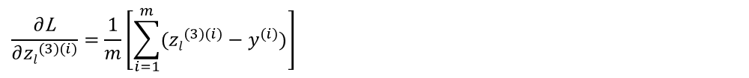

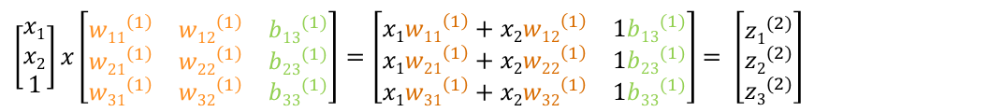




Das Multilayer Perceptron
$\left[\begin{matrix}x1 \\ x2 \\ 1\end{matrix}\right]x\left[\begin{matrix}{w11}^{\left(1\right)} & {w12}^{\left(1\right)} & {b13}^{(1)} \\ {w21}^{\left(1\right)} & {w22}^{\left(1\right)} & {b23}^{(1)} \\ {w31}^{\left(1\right)} & {w32}^{\left(1\right)} & {b33}^{(1)}\end{matrix}\right]$ $=\left[\begin{matrix}x1{w11}^{\left(1\right)}+x2{w12}^{\left(1\right)} & 1{b13}^{(1)} \\ x1{w21}^{\left(1\right)}+x2{w22}^{\left(1\right)} & 1{b23}^{(1)} \\ x1{w31}^{\left(1\right)}+x2{w32}^{\left(1\right)} & 1{b33}^{(1)}\end{matrix}\right]$ $= \left[\begin{matrix}{z1}^{(2)} \\ {z2}^{(2)} \\ {z3}^{(2)}\end{matrix}\right]$
$$σ\left(\left[\begin{matrix}{z1}^{(2)} \\ {z2}^{(2)} \\ {z3}^{(2)}\end{matrix}\right]\right)=\left[\begin{matrix}{a1}^{(2)} \\ {a2}^{(2)} \\ {a3}^{(2)}\end{matrix}\right]$$
$\left[\begin{matrix}{a1}^{\left(2\right)} \\ {a2}^{\left(2\right)} \\ {a3}^{\left(2\right)} \\ 1\end{matrix}\right]x\left[\begin{matrix}{w11}^{\left(2\right)} & {w12}^{\left(2\right)} & {w13}^{\left(2\right)} & {b14}^{(2)} \\ {w21}^{\left(2\right)} & {w22}^{\left(2\right)} & {w23}^{\left(2\right)} & {b24}^{(2)}\end{matrix}\right]=\left[\begin{matrix}{a1}^{\left(2\right)}{w11}^{\left(2\right)}+{a2}^{\left(2\right)}{w12}^{\left(2\right)}+{a3}^{\left(2\right)}{w13}^{\left(2\right)}+1{b14}^{\left(2\right)} \\ {a1}^{\left(2\right)}{w21}^{\left(2\right)}+{a2}^{\left(2\right)}{w22}^{\left(2\right)}+{a3}^{\left(2\right)}{w23}^{\left(2\right)}+1{b24}^{\left(2\right)}\end{matrix}\right]$ $= \left[\begin{matrix}{z1}^{(3)} \\ {z2}^{(3)}\end{matrix}\right]$
$$f\left(\left[\begin{matrix}{z1}^{(3)} \\ {z2}^{(3)}\end{matrix}\right]\right)=\left[\begin{matrix}{a1}^{(3)} \\ {a2}^{(3)}\end{matrix}\right]$$
$$L(w1, b)=\frac{1}{2m} \sum_{i=1}^{m}{{({zl}^{(3)(i)}−{yl}^{(i)})}^{2} }$$
$${\text{w}kj}^{(1)}≔{\text{w}kj}^{(1)}−α∗\frac{∂\text{L}}{∂{\text{w}kj}^{(1)}}\text{;}{ \text{b}k3}^{(1)}≔{ \text{b}k3}^{(1)}−α∗\frac{∂\text{L}}{{ \text{b}k3}^{(1)}}$$
$\frac{∂\text{L}}{∂{\text{v}kj}^{(1)}}=\frac{∂\text{L}}{∂{zl}^{(3)(i)}}\frac{{∂zl}^{(3)(i)}}{∂{ak}^{(2)(i)}}$ $\frac{∂{ak}^{(2)(i)}}{∂{zk}^{\left(2\right)\left(i\right)}}\frac{{∂zk}^{\left(2\right)\left(i\right)}}{∂{\text{v}kj}^{(1)}}$
$$\frac{∂\text{L}}{∂{zl}^{(3)(i)}}=\frac{1}{m}\left[\sum_{i=1}^{m}{({zl}^{(3)(i)}−y^{(i)})}\right]$$
$$\frac{{∂zl}^{(3)(i)}}{∂{ak}^{(2)(i)}}=\frac{∂}{∂{ak}^{(2)(i)}}\left({a1}^{\left(2\right)(i)}{wl1}^{\left(2\right)}+{a2}^{\left(2\right)(i)}{wl2}^{\left(2\right)}+{a3}^{\left(2\right)(i)}{wl3}^{\left(2\right)}+1{bl4}^{\left(2\right)}\right)={wlk}^{(2)}$$
$$\frac{∂{ak}^{(2)(i)}}{∂{zk}^{\left(2\right)\left(i\right)}}=\frac{∂}{{∂zk}^{\left(2\right)\left(i\right)}}σ({zk}^{\left(2\right)\left(i\right)})=σ\left({zk}^{\left(2\right)\left(i\right)}\right)∗\left(1−σ\left({zk}^{\left(2\right)\left(i\right)}\right)\right)$$
$$\frac{{∂zk}^{\left(2\right)\left(i\right)}}{∂{\text{v}kj}^{(1)}}=\frac{∂}{∂{\text{v}kj}^{(1)}}\left(x1{wk1}^{\left(1\right)}+x2{wk2}^{\left(1\right)}+1{bk4}^{\left(1\right)}\right)$$
$$\frac{∂\text{L}}{∂{\text{v}kj}^{(1)}}=\frac{1}{m}\left[\sum_{i=1}^{m}{({zl}^{(3)(i)}−y^{(i)})}\right]∗{wlk}^{\left(2\right)}∗σ\left({zk}^{\left(2\right)\left(i\right)}\right)∗\left(1−σ\left({zk}^{\left(2\right)\left(i\right)}\right)\right)∗\frac{∂}{∂{\text{v}kj}^{(1)}}\left(x1{wk1}^{\left(1\right)}+x2{wk2}^{\left(1\right)}+1{bk4}^{\left(1\right)}\right)$$

Slide 17
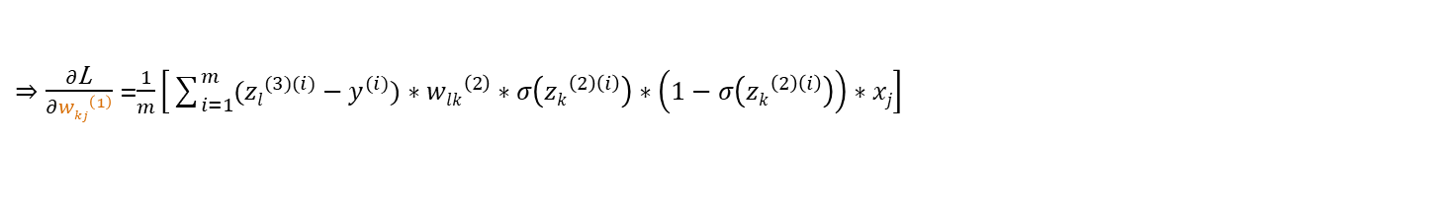
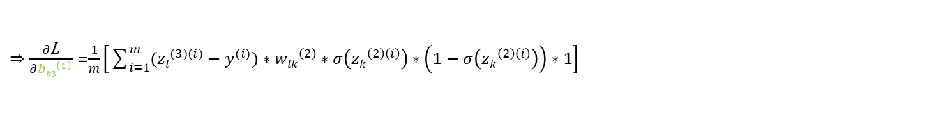
Das Multilayer Perceptron
$\left[\begin{matrix}x1 \\ x2 \\ 1\end{matrix}\right]x\left[\begin{matrix}{w11}^{\left(1\right)} & {w12}^{\left(1\right)} & {b13}^{(1)} \\ {w21}^{\left(1\right)} & {w22}^{\left(1\right)} & {b23}^{(1)} \\ {w31}^{\left(1\right)} & {w32}^{\left(1\right)} & {b33}^{(1)}\end{matrix}\right]$ $=\left[\begin{matrix}x1{w11}^{\left(1\right)}+x2{w12}^{\left(1\right)} & 1{b13}^{(1)} \\ x1{w21}^{\left(1\right)}+x2{w22}^{\left(1\right)} & 1{b23}^{(1)} \\ x1{w31}^{\left(1\right)}+x2{w32}^{\left(1\right)} & 1{b33}^{(1)}\end{matrix}\right]$ $= \left[\begin{matrix}{z1}^{(2)} \\ {z2}^{(2)} \\ {z3}^{(2)}\end{matrix}\right]$
$$σ\left(\left[\begin{matrix}{z1}^{(2)} \\ {z2}^{(2)} \\ {z3}^{(2)}\end{matrix}\right]\right)=\left[\begin{matrix}{a1}^{(2)} \\ {a2}^{(2)} \\ {a3}^{(2)}\end{matrix}\right]$$
$\left[\begin{matrix}{a1}^{\left(2\right)} \\ {a2}^{\left(2\right)} \\ {a3}^{\left(2\right)} \\ 1\end{matrix}\right]x\left[\begin{matrix}{w11}^{\left(2\right)} & {w12}^{\left(2\right)} & {w13}^{\left(2\right)} & {b14}^{(2)} \\ {w21}^{\left(2\right)} & {w22}^{\left(2\right)} & {w23}^{\left(2\right)} & {b24}^{(2)}\end{matrix}\right]=\left[\begin{matrix}{a1}^{\left(2\right)}{w11}^{\left(2\right)}+{a2}^{\left(2\right)}{w12}^{\left(2\right)}+{a3}^{\left(2\right)}{w13}^{\left(2\right)}+1{b14}^{\left(2\right)} \\ {a1}^{\left(2\right)}{w21}^{\left(2\right)}+{a2}^{\left(2\right)}{w22}^{\left(2\right)}+{a3}^{\left(2\right)}{w23}^{\left(2\right)}+1{b24}^{\left(2\right)}\end{matrix}\right]$ $= \left[\begin{matrix}{z1}^{(3)} \\ {z2}^{(3)}\end{matrix}\right]$
$$f\left(\left[\begin{matrix}{z1}^{(3)} \\ {z2}^{(3)}\end{matrix}\right]\right)=\left[\begin{matrix}{a1}^{(3)} \\ {a2}^{(3)}\end{matrix}\right]$$
$$L(w1, b)=\frac{1}{2m} \sum_{i=1}^{m}{{({zl}^{(3)(i)}−{yl}^{(i)})}^{2} }$$
$${\text{w}kj}^{(1)}≔{\text{w}kj}^{(1)}−α∗\frac{∂\text{L}}{∂{\text{w}kj}^{(1)}}\text{;}{ \text{b}k3}^{(1)}≔{ \text{b}k3}^{(1)}−α∗\frac{∂\text{L}}{{ \text{b}k3}^{(1)}}$$
$$\frac{∂\text{L}}{∂{\text{v}kj}^{(1)}}=\frac{1}{m}\left[\sum_{i=1}^{m}{({zl}^{(3)(i)}−y^{(i)})}∗{wlk}^{\left(2\right)}∗σ\left({zk}^{\left(2\right)\left(i\right)}\right)∗\left(1−σ\left({zk}^{\left(2\right)\left(i\right)}\right)\right)∗\frac{∂}{∂{\text{v}kj}^{(1)}}\left(x1{wk1}^{\left(1\right)}+x2{wk2}^{\left(1\right)}+1{bk4}^{\left(1\right)}\right)\right]$$
$⇒\frac{∂\text{L}}{∂{wkj}^{\left(1\right)}}$ =$\frac{1}{m}\left[\sum_{i=1}^{m}{({zl}^{(3)(i)}−y^{(i)})}∗{wlk}^{\left(2\right)}∗σ\left({zk}^{\left(2\right)\left(i\right)}\right)∗\left(1−σ\left({zk}^{\left(2\right)\left(i\right)}\right)\right)∗xj\right]$
$⇒\frac{∂\text{L}}{∂{bk3}^{\left(1\right)}}$ =$\frac{1}{m}\left[\sum_{i=1}^{m}{({zl}^{(3)(i)}−y^{(i)})}∗{wlk}^{\left(2\right)}∗σ\left({zk}^{\left(2\right)\left(i\right)}\right)∗\left(1−σ\left({zk}^{\left(2\right)\left(i\right)}\right)\right)∗1\right]$

Slide 18

















Das Multilayer Perceptron
z₁⁽²⁾ a₁⁽²⁾
$${w22}^{(2)}$$
$${w11}^{(1)}$$
$${w32}^{(2)}$$
x₁
$${w21}^{(1)}$$
z₁⁽³⁾ a₁⁽³⁾
$${w31}^{(1)}$$
$${w22}^{(2)}$$
$${w12}^{(1)}$$
z₂⁽²⁾ a₂⁽²⁾
$${w32}^{(2)}$$
flatten
x₂
$${w22}^{(1)}$$
$${w32}^{(1)}$$
z₂⁽³⁾ a₂⁽³⁾
$${w22}^{(2)}$$
$${b13}^{(1)}$$
$${w32}^{(2)}$$
$${b23}^{(1)}$$
z₃⁽²⁾ a₃⁽²⁾
₁
$${b33}^{(1)}$$
$${b11}^{(2)}$$
$${b21}^{(2)}$$
₁
1. faltende
Schicht
2. faltende
Schicht

Slide 19
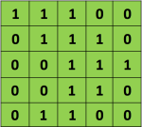
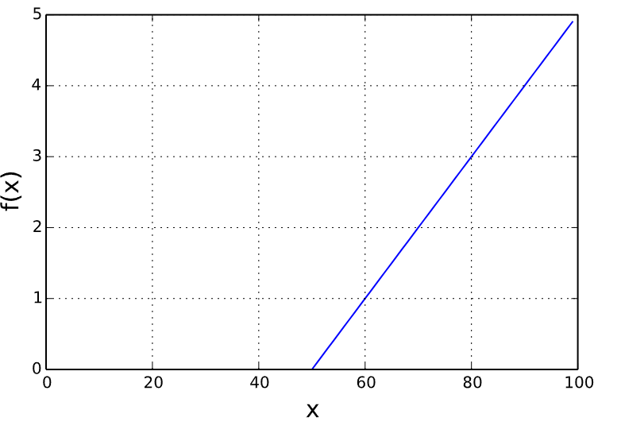





Die faltende Schicht
$$\left[\begin{matrix}12 & 9 & 12 \\ 6 & 12 & 9 \\ 6 & 9 & 12\end{matrix}\right]$$
$$f\left(\left[\begin{matrix}12 & 9 & 12 \\ 6 & 12 & 9 \\ 6 & 9 & 12\end{matrix}\right]\right)$$
$$\left[\begin{matrix}12 & 9 & 12 \\ 6 & 12 & 9 \\ 6 & 9 & 12\end{matrix}\right]$$
$$\left[\begin{matrix}12 & 12 \\ 12 & 12\end{matrix}\right]$$
Dimensionen von Fenster: 2x2
→ Max-Pooling
→ Durchschnitt-Pooling
Faltungs-Schritt (Convolution) → Parameter: Stride, Kernel, Kernel-Dimensionen, Anzahl Kernel
Aktivierungsfunktion → Parameter: -
Pooling → Parameter: Stride, Kernel-Dimensionen

Slide 20

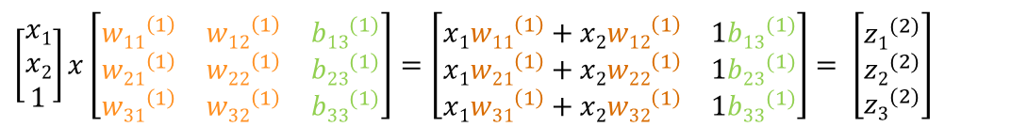

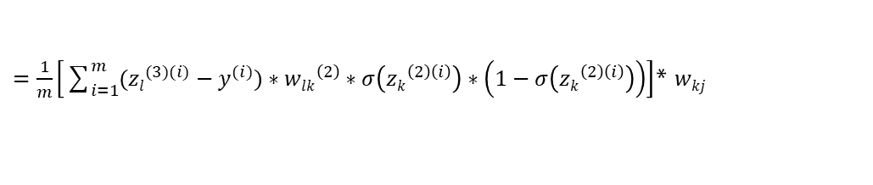
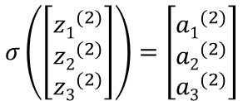

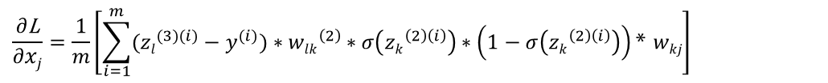

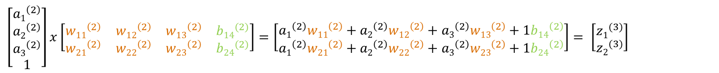
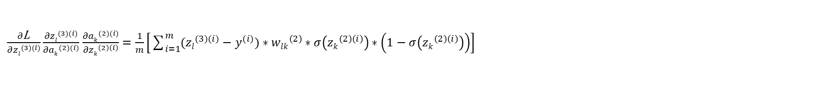
Das Multilayer Perceptron
$\left[\begin{matrix}x1 \\ x2 \\ 1\end{matrix}\right]x\left[\begin{matrix}{w11}^{\left(1\right)} & {w12}^{\left(1\right)} & {b13}^{(1)} \\ {w21}^{\left(1\right)} & {w22}^{\left(1\right)} & {b23}^{(1)} \\ {w31}^{\left(1\right)} & {w32}^{\left(1\right)} & {b33}^{(1)}\end{matrix}\right]$ $=\left[\begin{matrix}x1{w11}^{\left(1\right)}+x2{w12}^{\left(1\right)} & 1{b13}^{(1)} \\ x1{w21}^{\left(1\right)}+x2{w22}^{\left(1\right)} & 1{b23}^{(1)} \\ x1{w31}^{\left(1\right)}+x2{w32}^{\left(1\right)} & 1{b33}^{(1)}\end{matrix}\right]$ $= \left[\begin{matrix}{z1}^{(2)} \\ {z2}^{(2)} \\ {z3}^{(2)}\end{matrix}\right]$
$$σ\left(\left[\begin{matrix}{z1}^{(2)} \\ {z2}^{(2)} \\ {z3}^{(2)}\end{matrix}\right]\right)=\left[\begin{matrix}{a1}^{(2)} \\ {a2}^{(2)} \\ {a3}^{(2)}\end{matrix}\right]$$
$\left[\begin{matrix}{a1}^{\left(2\right)} \\ {a2}^{\left(2\right)} \\ {a3}^{\left(2\right)} \\ 1\end{matrix}\right]x\left[\begin{matrix}{w11}^{\left(2\right)} & {w12}^{\left(2\right)} & {w13}^{\left(2\right)} & {b14}^{(2)} \\ {w21}^{\left(2\right)} & {w22}^{\left(2\right)} & {w23}^{\left(2\right)} & {b24}^{(2)}\end{matrix}\right]=\left[\begin{matrix}{a1}^{\left(2\right)}{w11}^{\left(2\right)}+{a2}^{\left(2\right)}{w12}^{\left(2\right)}+{a3}^{\left(2\right)}{w13}^{\left(2\right)}+1{b14}^{\left(2\right)} \\ {a1}^{\left(2\right)}{w21}^{\left(2\right)}+{a2}^{\left(2\right)}{w22}^{\left(2\right)}+{a3}^{\left(2\right)}{w23}^{\left(2\right)}+1{b24}^{\left(2\right)}\end{matrix}\right]$ $= \left[\begin{matrix}{z1}^{(3)} \\ {z2}^{(3)}\end{matrix}\right]$
$$f\left(\left[\begin{matrix}{z1}^{(3)} \\ {z2}^{(3)}\end{matrix}\right]\right)=\left[\begin{matrix}{a1}^{(3)} \\ {a2}^{(3)}\end{matrix}\right]$$
$=\frac{1}{m}\left[\sum_{i=1}^{m}{({zl}^{(3)(i)}−y^{(i)})}∗{wlk}^{\left(2\right)}∗σ\left({zk}^{\left(2\right)\left(i\right)}\right)∗\left(1−σ\left({zk}^{\left(2\right)\left(i\right)}\right)\right)\right]$* $wkj$
$$L(w1, b)=\frac{1}{2m} \sum_{i=1}^{m}{{({zl}^{(3)(i)}−{yl}^{(i)})}^{2} }$$
$${\text{w}ih}^{(0)}≔{\text{w}ih}^{(0)}−α∗\frac{∂\text{L}}{∂{\text{w}ih}^{(0)}}$$
$\frac{∂\text{L}}{∂{\text{w}ih}^{(0)}}=\frac{∂\text{L}}{∂{zl}^{(3)(i)}}\frac{{∂zl}^{(3)(i)}}{∂{ak}^{(2)(i)}}$ $\frac{∂{ak}^{(2)(i)}}{∂{zk}^{\left(2\right)\left(i\right)}}\frac{{∂zk}^{\left(2\right)\left(i\right)}}{∂xj}\frac{∂xj}{{\text{w}ih}^{(0)}}$
$\frac{∂\text{L}}{∂{zl}^{(3)(i)}}\frac{{∂zl}^{(3)(i)}}{∂{ak}^{(2)(i)}}$ $\frac{∂{ak}^{(2)(i)}}{∂{zk}^{\left(2\right)\left(i\right)}}=\frac{1}{m}\left[\sum_{i=1}^{m}{({zl}^{(3)(i)}−y^{(i)})}∗{wlk}^{\left(2\right)}∗σ\left({zk}^{\left(2\right)\left(i\right)}\right)∗\left(1−σ\left({zk}^{\left(2\right)\left(i\right)}\right)\right)\right]$
$$\frac{{∂zk}^{\left(2\right)\left(i\right)}}{∂xj}=\frac{∂}{∂xj}\left(x1{wk1}^{\left(1\right)}+x2{wk2}^{\left(1\right)}+1{bk4}^{\left(1\right)}\right)=wkj$$
$$\frac{∂\text{L}}{∂xj}=\frac{1}{m}\left[\sum_{i=1}^{m}{({zl}^{(3)(i)}−y^{(i)})}∗{wlk}^{\left(2\right)}∗σ\left({zk}^{\left(2\right)\left(i\right)}\right)∗\left(1−σ\left({zk}^{\left(2\right)\left(i\right)}\right)\right)\text{* }wkj\right]$$

